Slide 1
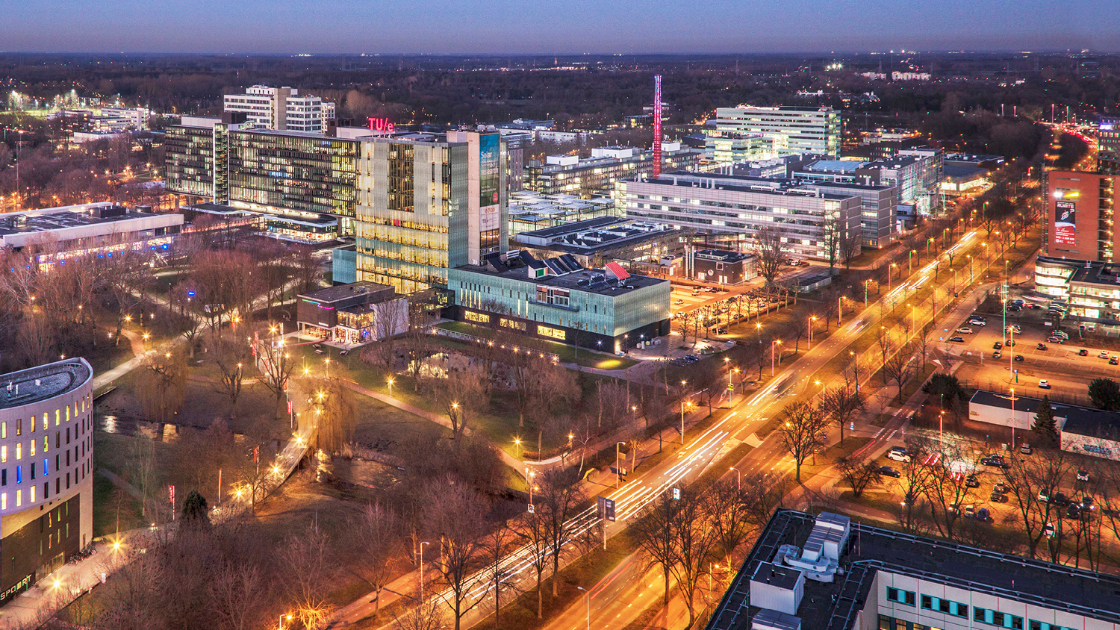
Presentation SSA 2
10 FEB 2021
Fransen, Student
Mechanical Engineering, 4GB10, Group 007

Slide 2
Goal
Make a p-V diagram based on theoretical computations

Slide 3
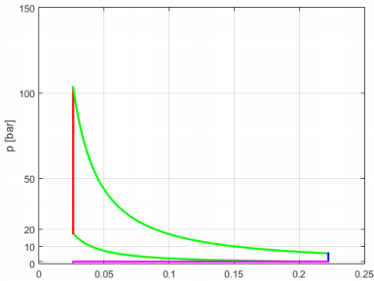
Goal

Slide 4
Where to start?
Fill in as many variables as I could

Slide 5
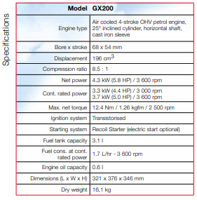
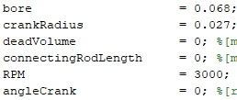

Found variables
Data sheet provided by Honda

Slide 6
Now what?

Slide 7
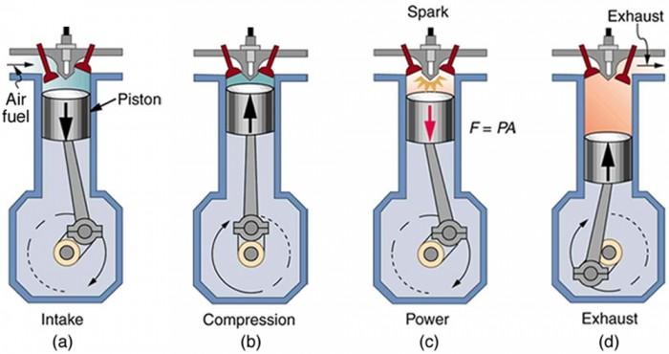
Table
 | p | V | T
1
2
3
4

Slide 8
Table
 | p | V | T
1 |  |  | Ambient temperature?
2
3
4

Slide 9
T1

Slide 10
Table
 | p | V | T
1 |  |  | Tamb
2
3
4 | Ambient pressure? |  | Exhaust temperature?

Slide 11
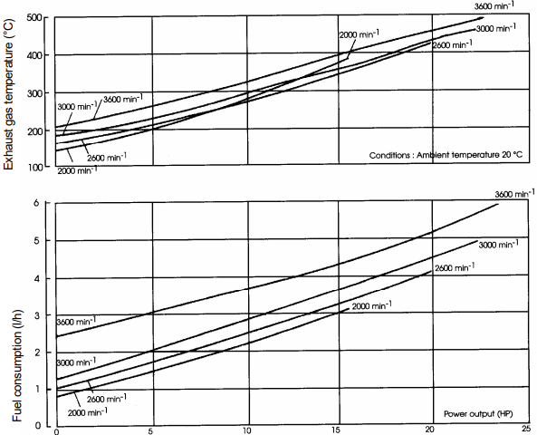
Found variables
Instruction manual from the depths of the internet
(air pressure comes from weather forecast)

Slide 12
Table
 | p | V | T
1 |  |  | Tamb
2
3
4 | pamb |  | Texh

Slide 13
Table
 | p | V | T
1 | p1 |  | Tamb
2
3
4 | pamb |  | Texh
Isochoric

Slide 14

Table
 | p | V | T
1 | p1 | V1 | Tamb
2
3
4 | pamb | V1 | Texh
Isochoric + Ideal gas law

Slide 15
Table
 | p | V | T
1 | p1 | V1 | Tamb
2
3
4 | pamb | V1 | Texh
STUCK FOR TWO HOURS.

Slide 16
Table
 | p | V | T
1 | p1 | V1 | Tamb
2 |  | V2
3
4 | pamb | V1 | Texh

Slide 17
Table
 | p | V | T
1 | p1 | V1 | Tamb
2 |  | V2
3 |  | V2
4 | pamb | V1 | Texh
Isochoric

Slide 18
Table
 | p | V | T
1 | p1 | V1 | Tamb
2 | p2 | V2
3 |  | V2
4 | pamb | V1 | Texh
Adiabatic ideal

Slide 19

Table
 | p | V | T
1 | p1 | V1 | Tamb
2 | p2 | V2 | T2
3 |  | V2
4 | pamb | V1 | Texh
Ideal gas

Slide 20
Table
 | p | V | T
1 | p1 | V1 | Tamb
2 | p2 | V2 | T2
3 |  | V2
4 | pamb | V1 | Texh
How?

Slide 21




Formulas from book
Datasheet to find W

Slide 22
Table
 | p | V | T
1 | p1 | V1 | Tamb
2 | p2 | V2 | T2
3 | p3 | V2 | T3
4 | pamb | V1 | Texh
Isochoric ideal

Slide 23
Time to make a p-V diagram.

Slide 24
What do we need?
General plotting code (legend, axes, etc.)
Initial starting line (V2 → V1, no pressure difference)
1-2 line Adiabatic; pV^(cp/cv) = constant
2-3 line Isochoric; V = constant
3-4 line Adiabatic; pV^(cp/cv) = constant
4-1 line Isochoric; V = constant

Slide 25
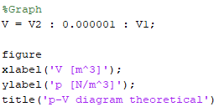
What do we need?
General plotting code (legend, axes, etc.)

Slide 26

What do we need?
Initial starting line (V2 → V1, no pressure difference)

Slide 27

What do we need?
1-2 line Adiabatic; pV^(cp/cv) = constant

Slide 28

What do we need?
2-3 line Isochoric; V = constant

Slide 29
Show me the graph!

Slide 30

I cannot…

Slide 31
Questions?
That I can actually answer

